Slide 1
WELCOME! Patient Advocacy Leaders United for Veterans’ Health & Rare Diseases Hill Briefing
Improving Care for Veterans with Rare Diseases: Establishing a National Commission
July 10, 2024 9:00 am – 10:00 am
U.S. Capitol Visitor Center North Congressional Meeting Room (CVC 268)

Slide 2
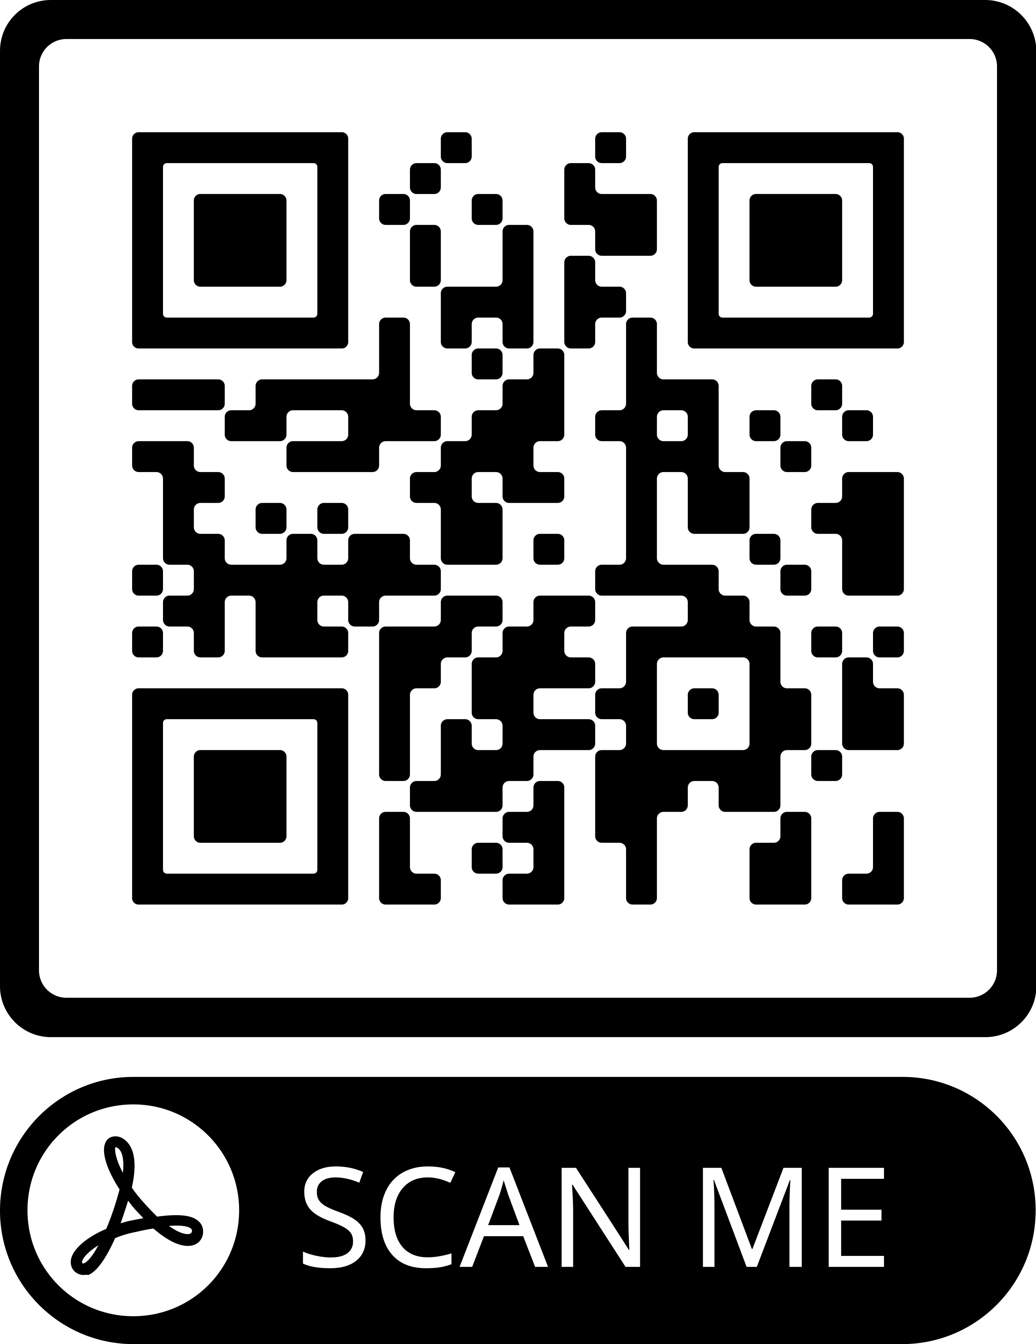
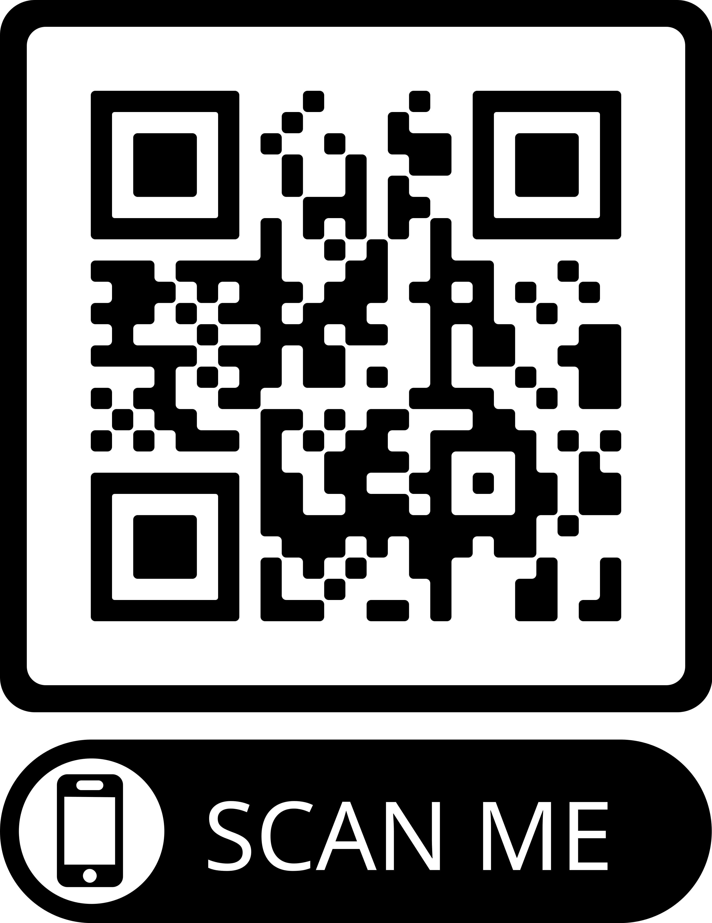
CPALs & PALs United for Veterans’ Health & Rare Disease
#CPALsAdvocates
Center for Patient Advocacy Leaders
Improving Care for Veterans with Rare Diseases: A Blueprint for Action
#veterans
#rarediseases

Slide 3
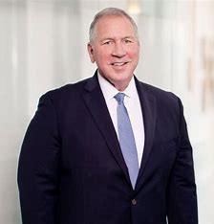
Welcoming Remarks
Edward V. Hickey III – Moderator
President, American Association of Kidney Patients (AAKP)
Chair, AAKP Veterans Health Initiative, U.S.M.C.

Slide 4
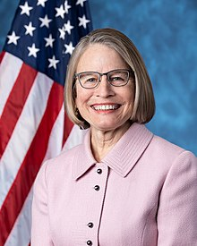
Sponsor Opening Remarks
Rep. Mariannette Miller-Meeks, M.D., LTC US Army, Ret. (IA-01)
Chairwoman, Subcommittee on Health, House Committee on Veterans' Affairs
Member, Rare Disease Caucus

Slide 5
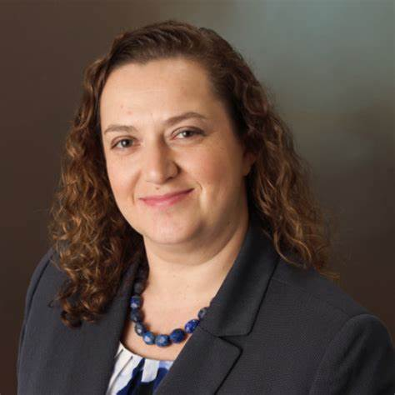
Rare Disease Community Perspective
Jamie Sullivan
Vice President of Policy
EveryLife Foundation for Rare Diseases

Slide 6
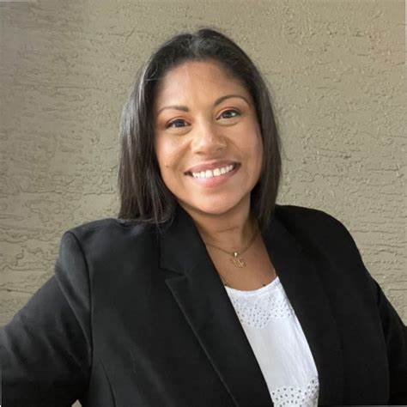
Veterans Community Perspective
Naomi Mathis
Assistant National Legislative Director
Disabled American Veterans (DAV), USAF, Ret.

Slide 7
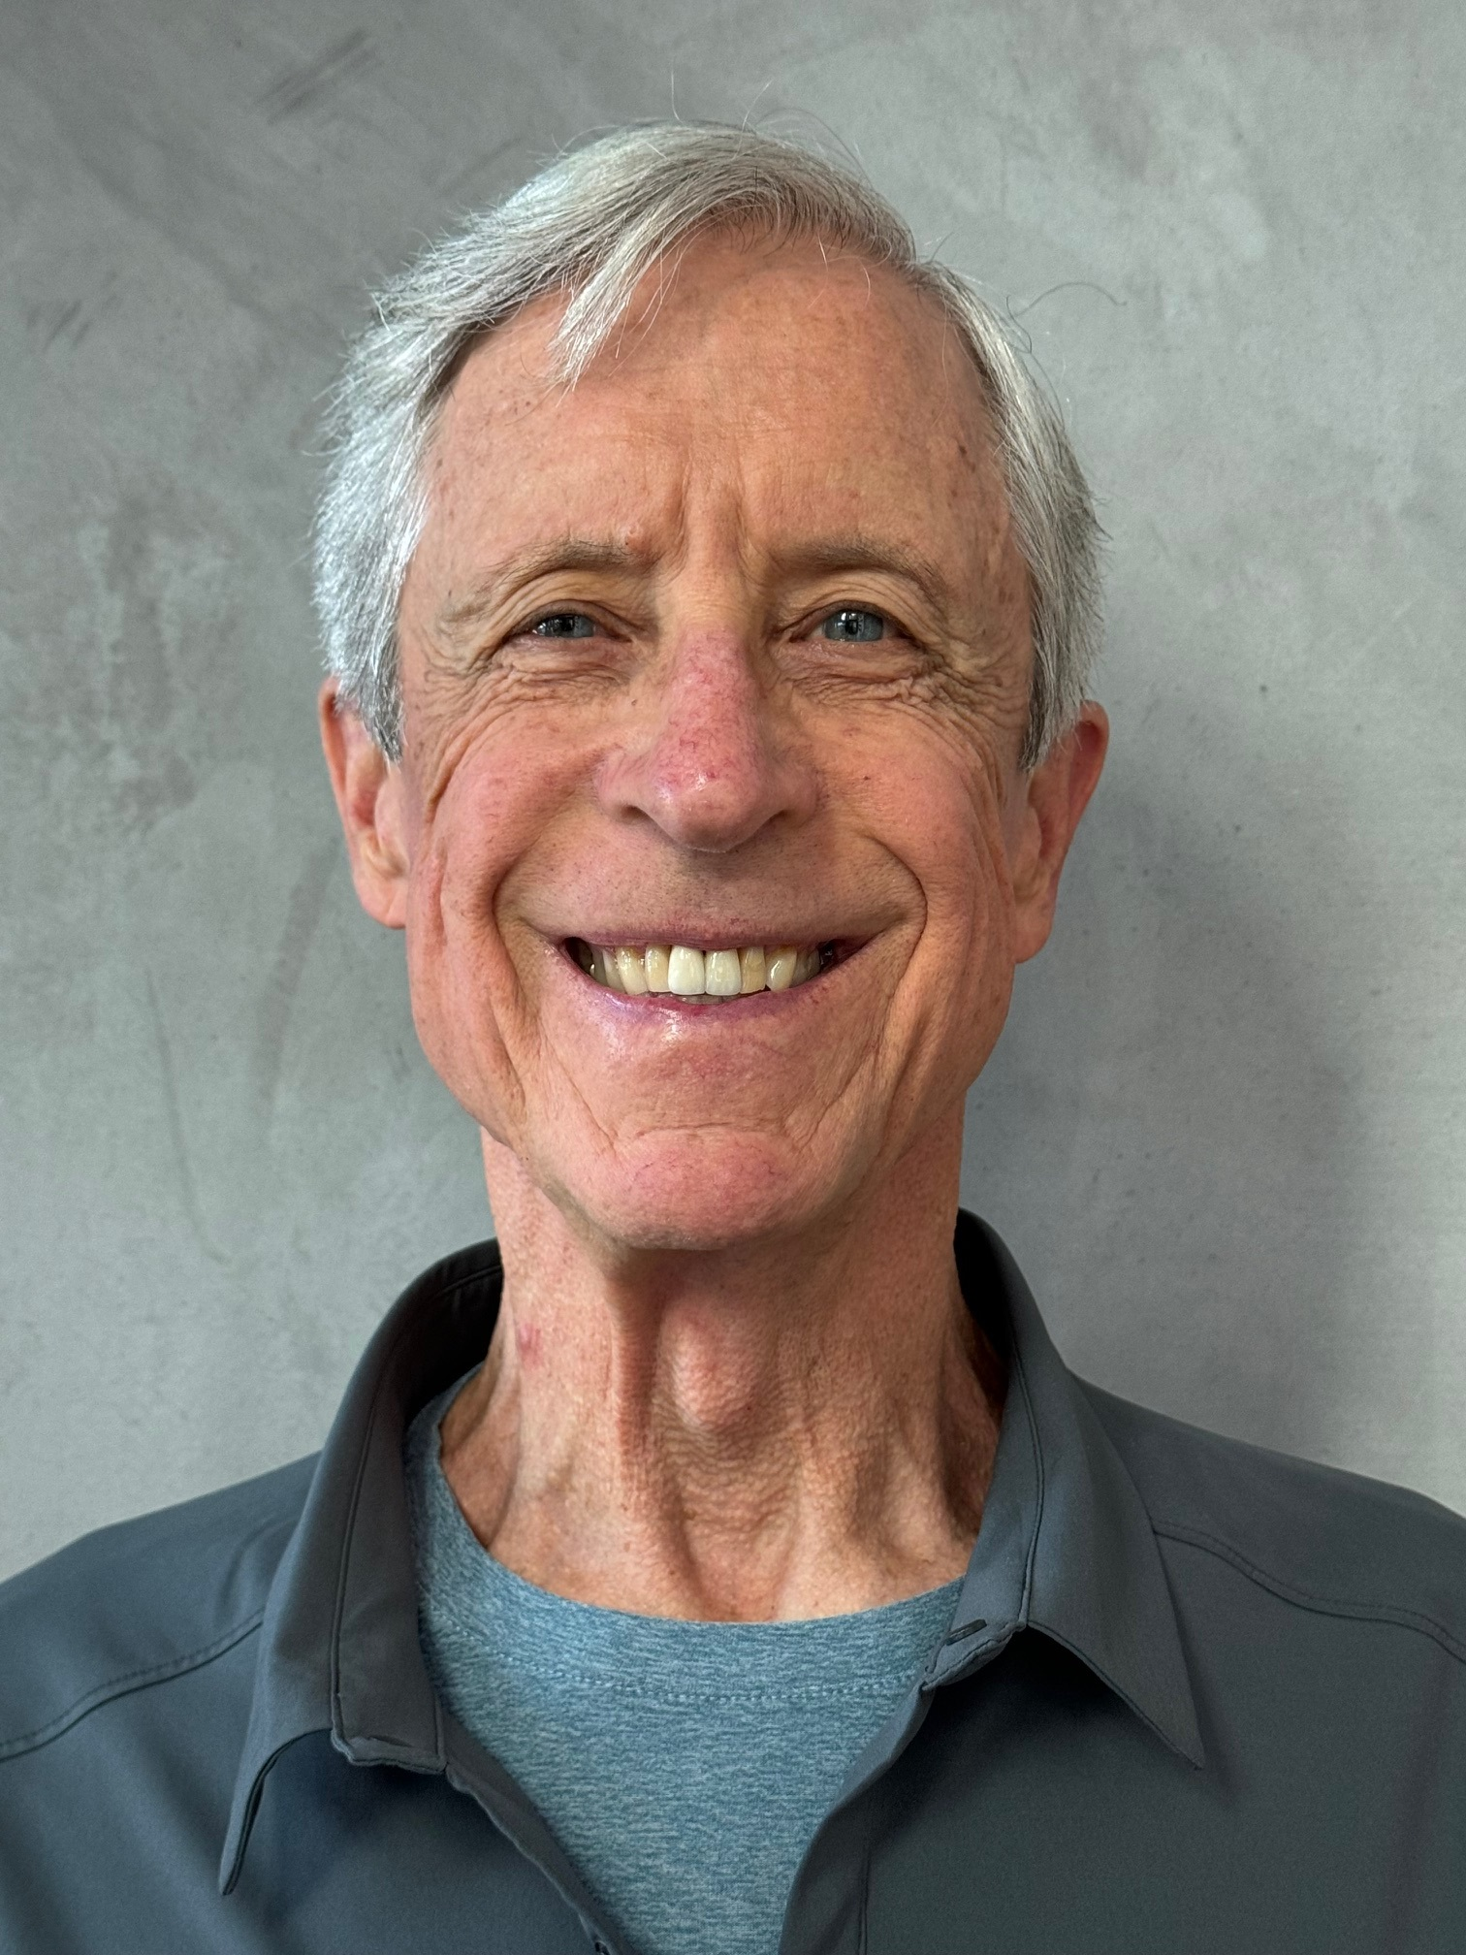
A Patient’s Perspective
Paul Tordella
Corporal U.S.M.C. 1967-1969
Vietnam 1968-1969
Retired Small Business Owner

Slide 8
Q&A

Slide 9
THANK YOU!

