Slide 1
TD Education: Working With Legislators, Community Organizations, and Law Enforcement September 21, 2023 Greg Hansch Executive Director, NAMI Texas

Slide 2
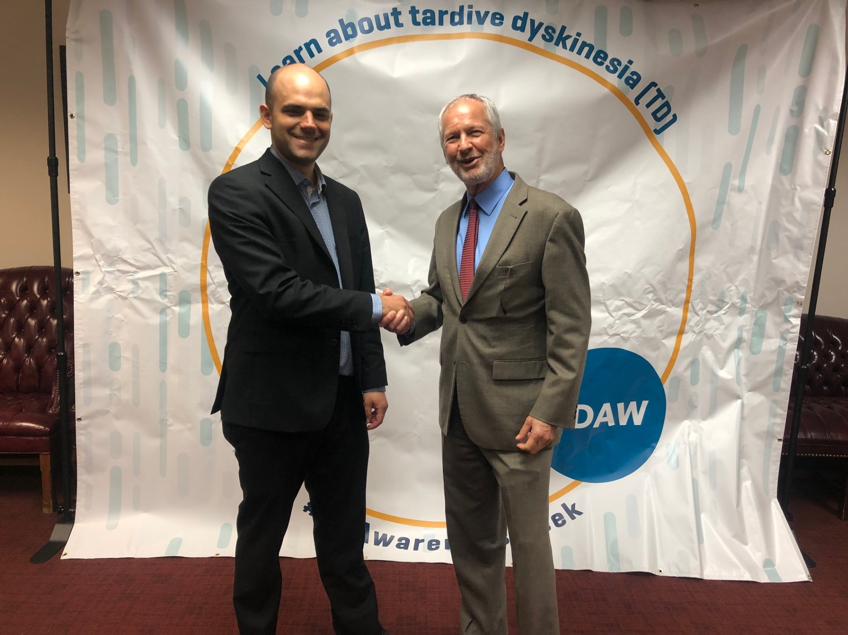
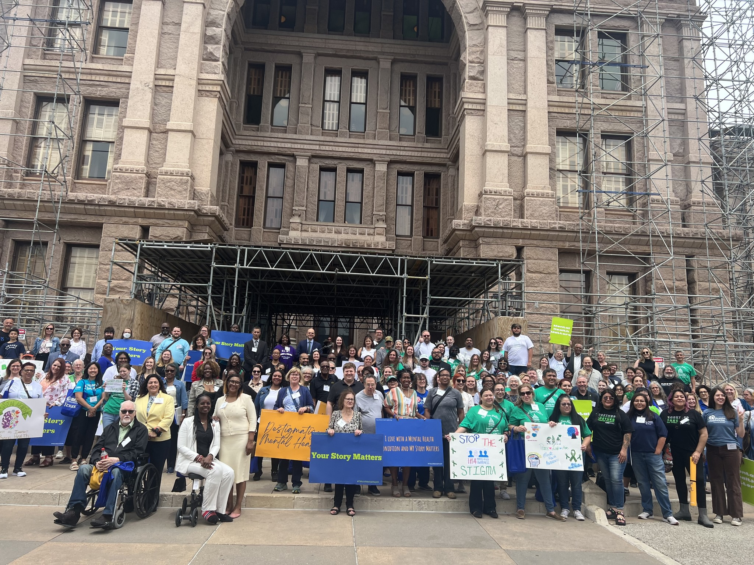
.
Engaging With Legislators
Make it easy for them
Show appreciation and provide incentives
Get their constituents involved
Leverage your NAMI advocacy pillar

Slide 3
Find me an audience that doesn’t love a visual aid

Slide 4
How to reach providers
NAMI Programming and Other NAMI Educational Efforts
NAMI Provider
Your Annual Conference
NAMI In Our Own Voice
Webinars and live presentations geared toward provider communities
Identify and leverage TD provider champions
Medical Science Liaisons
Academic Researchers
Psych Congress / College of Psychiatric Pharmacists
Non-NAMI Conferences
Counselors
Social Workers
Psychiatrists
CMHCs
Peer Support Specialists
Target social media advertising towards provider community
Facebook/Meta/Instagram advertising allows you to direct advertising

Slide 5
.
Why and How: Law Enforcement and Criminal Justice
Why
How
TD disproportionate representation in criminal justice
Lack of understanding -> negative outcomes
For the same reasons we promote CIT
We have their attention
NAMI Programs+: SYSLE, IOOV, CIT, Conference, Webinars
Their Conferences: CIT, Sheriffs, Municipal Police, Jailers
Trusted messengers
Targeted advertising

Slide 6
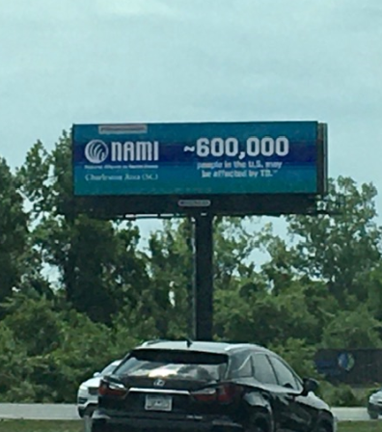
Tip: Bring the message to the people

Slide 7
Social media and e-newsletter are low-hanging fruit; use them

Slide 8
A few messaging guidelines
Grab their attention by portraying stark reality
Provide the prevalence data point – helps people connect
Personal stories are the special sauce
Provider perspective brings in trust, science, credibility
Help is available and recovery is possible

