Slide 1
Overview of the Current Pain/Pain Management Landscape
Patient Advocacy Leaders United for Veterans’ Health: Collaborating on Issues of Pain and Pain Management
Amanda Zimmerman, PA-C
West Forsyth Pain Management
Winston Salem, NC

Slide 2
Disclosures
Speaker bureau
Averitas
Salix

Slide 3
Objectives
Learn about the incidence of chronic pain
Understand the complexity of pain pathophysiology
Discuss barriers to pain treatment
Review causes and result of stigma in the chronic pain population
Focus on the biopsychosocial approach
Review the Veteran’s Administration approach to pain care
Introduce advances in chronic pain management

Slide 5
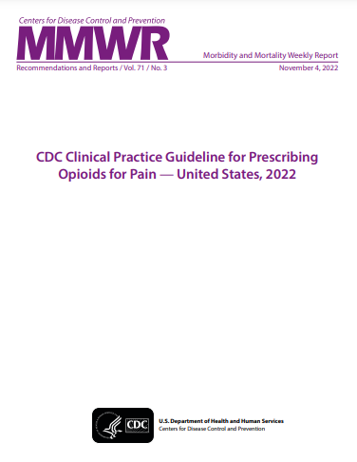
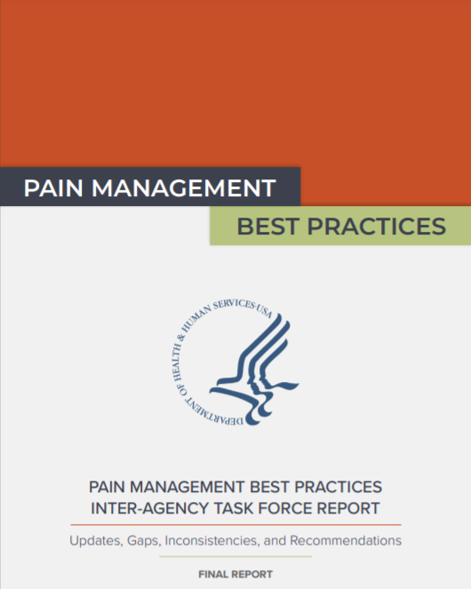
Pain Treatment Is Vital
Chronic pain affects 20.9% of US adults
Higher prevalence in non-Hispanic American Indians or Alaska Natives, those identifying as bisexual, and those who are divorced/separated
6.9% of US adults have “high-impact” pain, affecting life/work
Use of a team approach and evidence based medicine to address the biopsychosocial aspects of pain will improve the likelihood of success
Guidelines include DHHS 2019, CDC 2022
Rikard.MMWR Morb Mortal Wkly Rep. 2023;73:379.. www.hhs.gov/sites/default/files/pmtf-final-report-2019-05-23.pdf. Dowell. MMWR Recomm Rep. 2022;71:1 .
Notes:
EBM, evidence-based medicine.

Slide 6
Pain Pathophysiology Plasticity = “Wind-up”
Plasticity: the brain's ability to reorganize itself by forming new neural connections, which can lead to both beneficial and detrimental changes in pain perception and processing.
Injury/Incision
Acute Pain
“sensitization”
Normal Healing
Healing with plasticity
Hyperalgesia
Allodynia
Pain Relief
Subacute or
Chronic Pain

Slide 7
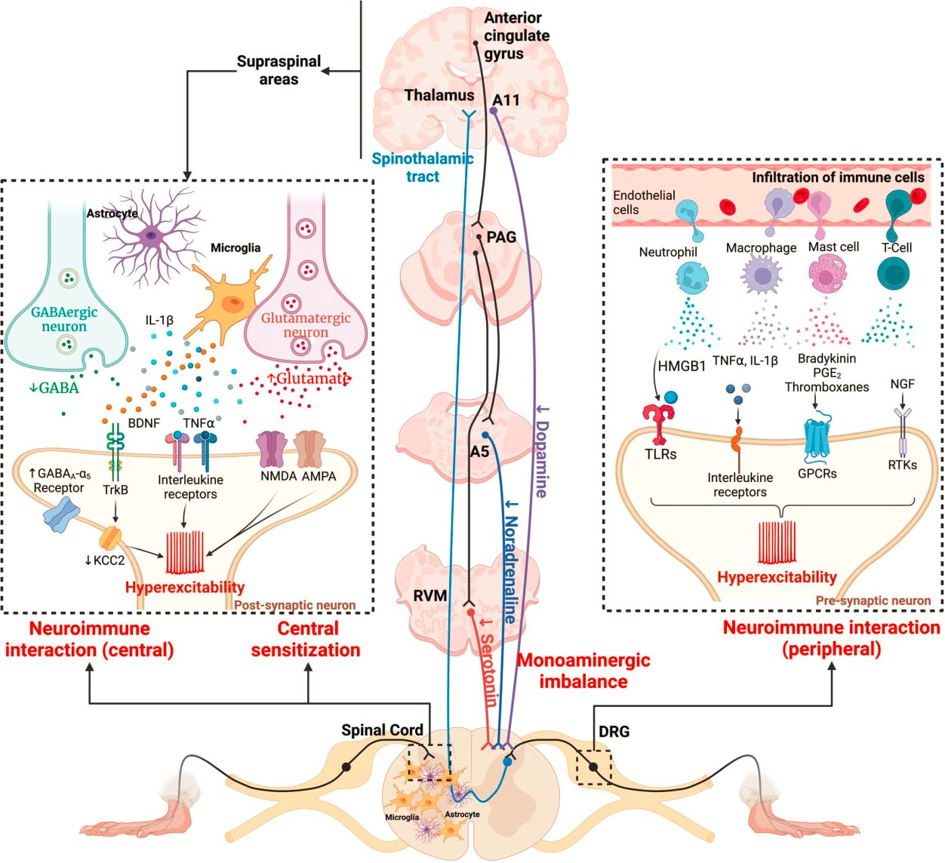
https://pubmed.ncbi.nlm.nih.gov/38595206/

Slide 8
Treatment Goals
Acute Pain
Facilitate recovery/healing
Minimize impact of pain
Reduce pain intensity
Provide recovery-focused rehabilitation
Improve quality of life
Minimize adverse events
Prevent transition to chronic pain
Chronic Pain
Restore function
Physical, emotional, social
Reduce pain intensity
Treat underlying cause of pain
Improve quality of life
Minimize adverse events
Correct consequences of pain
Postural deficits, deconditioning
Maladaptive behavior, coping
Palliative Care Pain
Symptom management
Relieve pain and other distressing symptoms
Optimize quality of life
Comfort care with or without intent to reach “cure”
Support system for families
Plan comorbid care needs
Psychological
Spiritual
Henry. Clin J Pain. 2017; 33:955. hhs.gov/sites/default/files/pmtf-final-report-2019-05-23.pdf.
oregonpainguidance.org/guideline/pain-control-for-cancer-and-palliative-care.

Slide 9
Barrier to Therapies: Fear Avoidance
Disuse Disability Depression
Injury
Fear Avoidance
Recovery
Defensive Motivation
Pain Experience
eg, overgeneralization, heightened emotions, jumping to conclusions
Arousal
Confrontation
Fear of Pain
Threat Perception
Low Fear
Catastrophizing
eg, rumination, magnification, feeling of helplessness
Can be managed with graded exposure therapy
Develop individualized hierarchy of feared/avoided activities; confront activities from least to most feared
Zale. Curr Opin Psychol. 2015;5:24. www.practicalpainmanagement.com/treatments/psychological/cognitive-behavioral-therapy/ fear-avoidance-chronic-pain-helping-patients.
Notes:
The fear avoidance model holds that an individual's fear of pain leads to avoiding perceived aggravating activity, leading to disability, deconditioning, and depression...this leads to catastrophizing...
Which further exacerbates the pain and creates a vicious cycle
The take home message of this is the need to change the narrative – to interrupt the cycle. This can be done in various ways, including graded exposure – gradually exposing the feared situation in a controlled manner, as well cognitive behavioral techniques

Slide 10
Acute Pain Options
Reduce Pain and Inflammation
APAP/Ibu
Topical Agents
Diclofenac
capsaicin
Muscle Relaxers
Corticosteroids
Antidepressants
Anticonvulsants
Massage Therapy
Accupuncture
Physical Therapy
CBT/ACT
Chiropractic treatment
Exercise
Mindfulness/meditation

Slide 11
Undertreatment of Pain Involves Multiple Factors
Underestimate severity/impact of patients’ pain
HCP factors
Patient factors
Fear of disciplinary action or prosecution
Combination of factors
Limited access to healthcare and/or pain specialists
Potential
for misuse/addiction
Fear of addiction, tolerance, and AEs
Lack of training in
opioid use
Socioeconomic and psychological factors
Undertreatment
of Chronic Pain
Implicit biases (eg, racial/ethnic, gender)
Poor patient knowledge of treatment options
Communication between physician and patient
Governmental and public policy on payment for opioid analgesics
Goree. Curr Opin Anaesthesiol. 2022;35:273. Barry. J Pain. 2010;11:1442. Ghoshal. J Pain Res. 2020;13:2825. Richard. J Pain Symptom Manage. 2005;29:206. Jamison. J Opioid Manage. 2014;10:375. Jung. Pain Med. 2006;7:353. McCracken. J Pain. 2006; 7:726. Primm. J Natl Med Assoc. 2004;96:1152. Al-Mahrezi. Oman Med J. 2017;32:357. Green. J Pain. 2005;6:689. Glachen. J Am Board Fam Pract. 2001;14:211.
Notes:
AE, adverse event; HCP, healthcare professional.

Slide 12
Biopsychosocial Spiritual Context of Pain
Biological
Sleep/fatigue
Inflammation
Gender
Nutritional status
Conditioning
Previous pain experience
Social
Work status
Intimacy
Relationships
Finances
Family
Psychological
Resilience
Anxiety
Childhood trauma
Grief
Depression
Catastrophizing
Spiritual
Religious faith
Existential issues
Suffering
Spiritual distress
Values
Empathy from HCP
Experience of pain
Matteliano. Manag Nurs. 2014;15:391.
Notes:
HCP, healthcare professional.

Slide 13
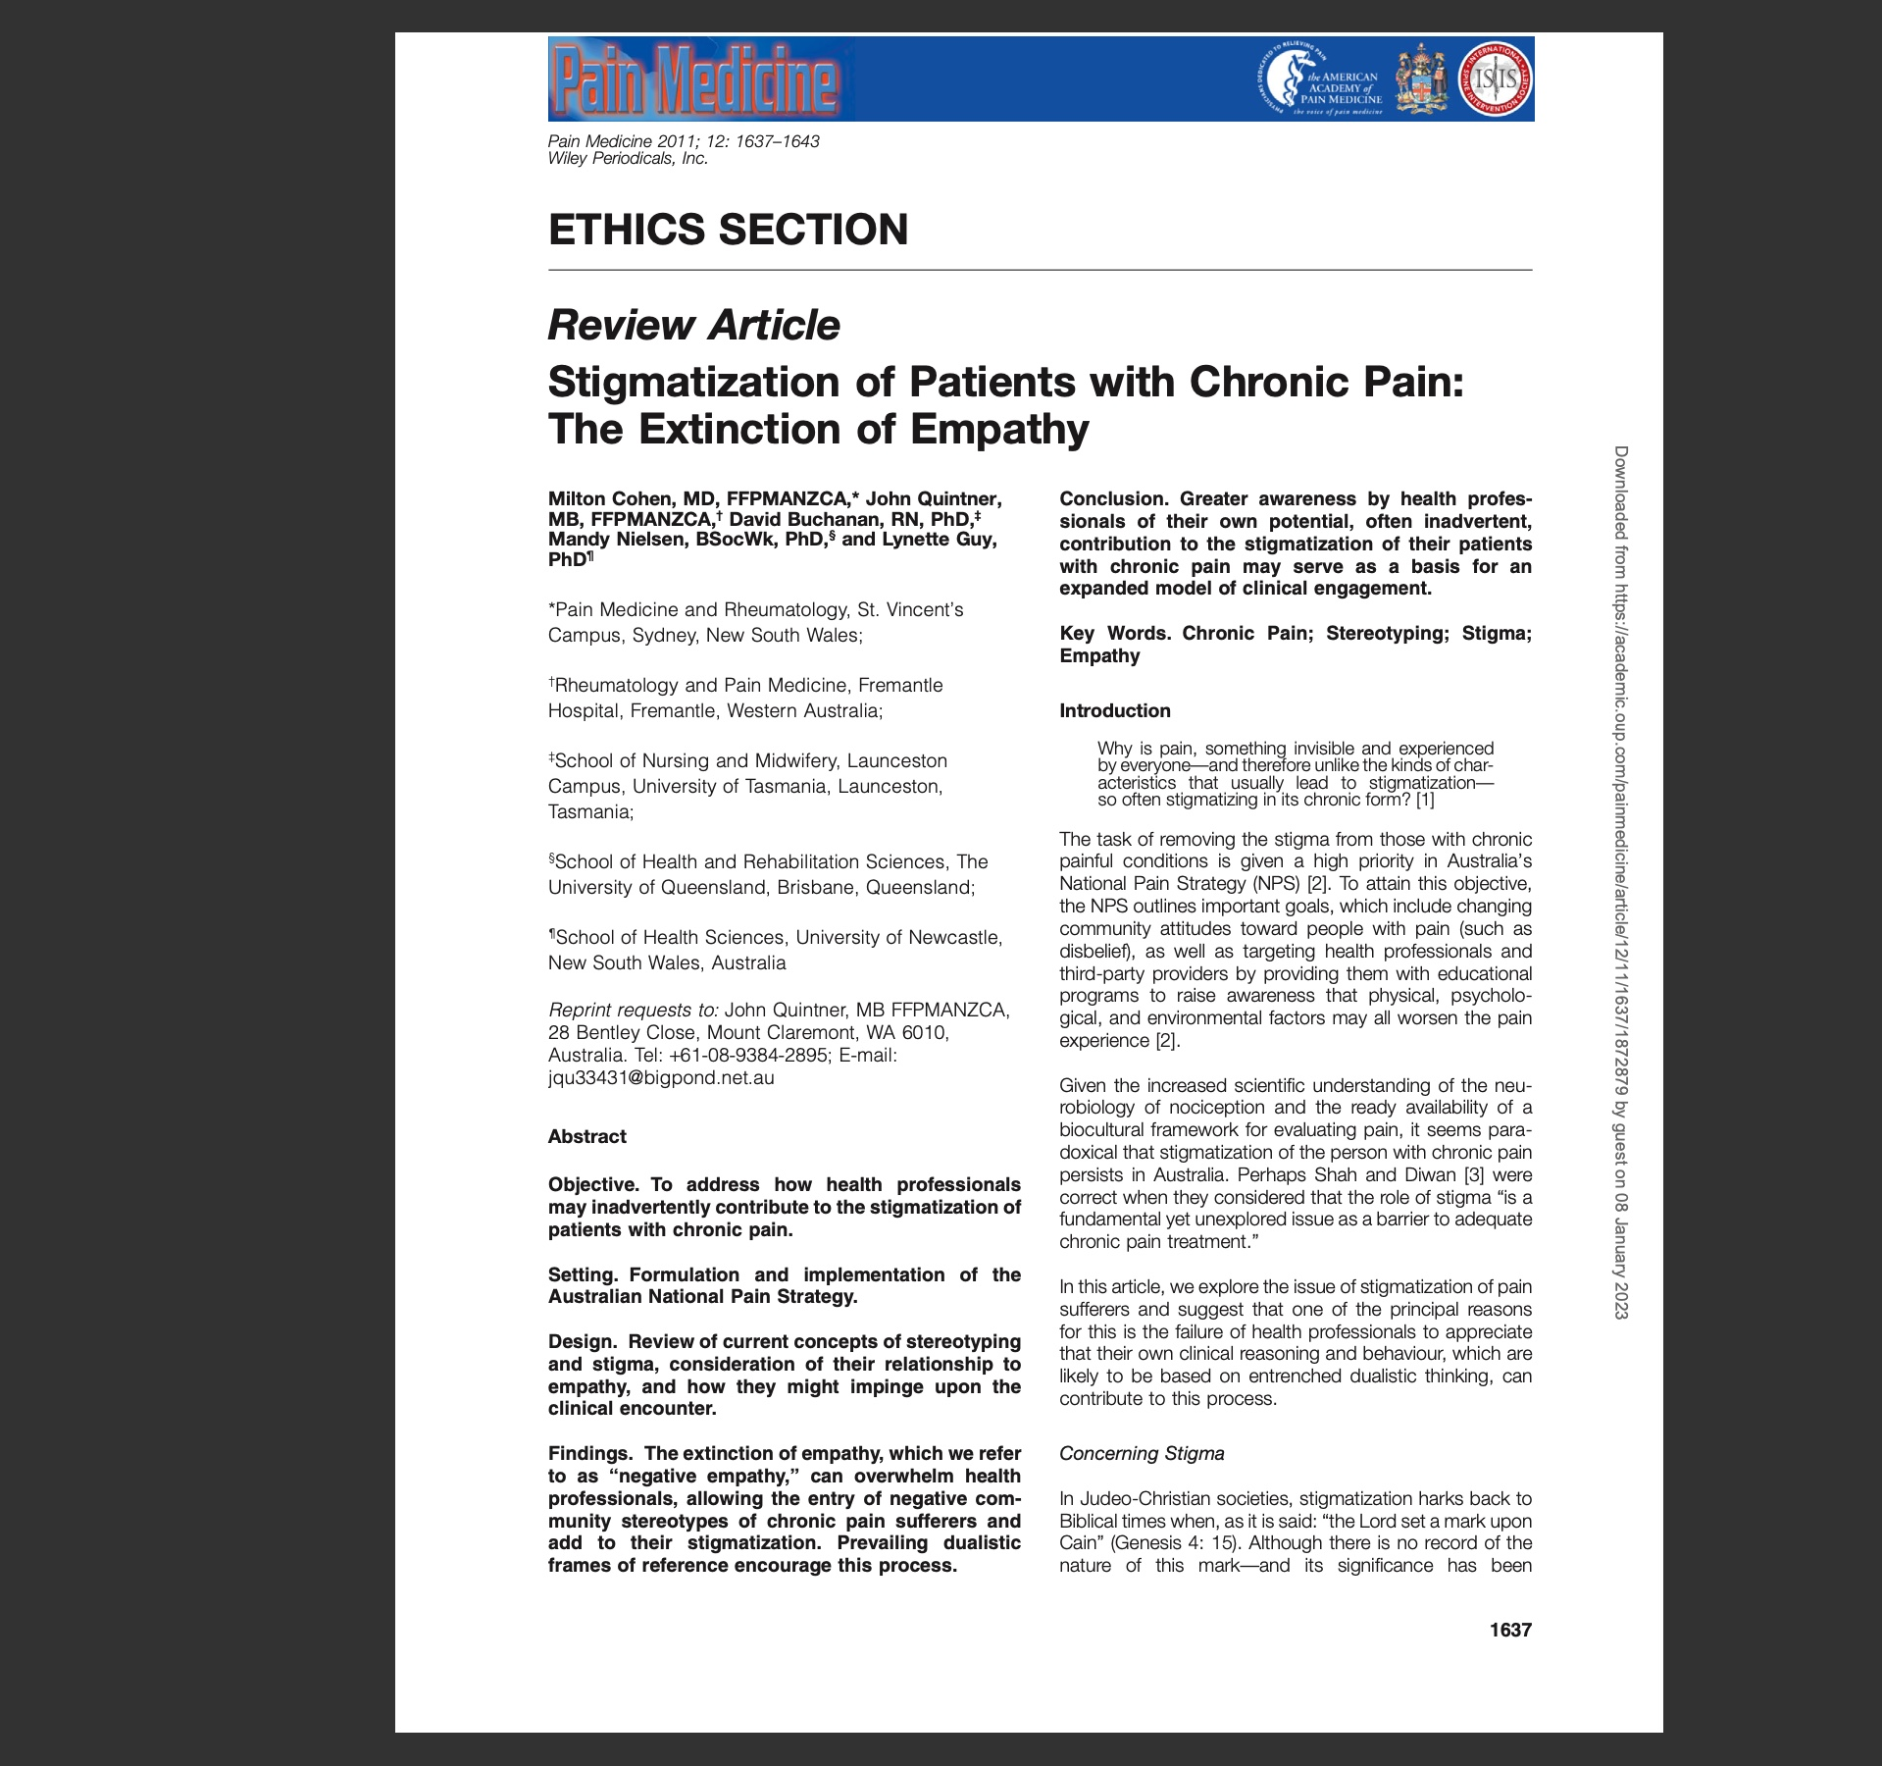
Stigma and pain
Descartes (1644) Cartesian dualism theory of pain
human beings consist of a mind or soul which is distinct from an extended body
Allows us to believe pain sufferers are either a disordered bodily machine or a disturbed mind
Western medicine places objective data over subjective allowing us to suspect a disturbed mind over an actual physical ailment
Allows for stereotyping and judgement
Sometimes chronic pain complaints do not fit into specific diagnostic criteria, further alienating the pain population from providers
Consequence is stigma
loss of status
Discrimination with access to healthcare
Loss of voice
Cohen M, Quintner J, Buchanan D, Nielsen M, Guy L. Stigmatization of patients with chronic pain: the extinction of empathy. Pain Med. 2011 Nov;12(11):1637-43. doi: 10.1111/j.1526-4637.2011.01264.x. Epub 2011 Nov 4. PMID: 22054062.

Slide 14
The conundrum
Clinical relationships are “morally charged”
Should the patient fail to validate their symptoms, or challenge the provider, they may acquire a negative label, allowing the provider to question their motives and diminish the legitimacy or reality of their symptoms
Clinicians can encounter the same lack of validation, not only from the patient, but also from regulatory authorities, particularly in regard to prescribing opioid medications
Cohen M, Quintner J, Buchanan D, Nielsen M, Guy L. Stigmatization of patients with chronic pain: the extinction of empathy. Pain Med. 2011 Nov;12(11):1637-43. doi: 10.1111/j.1526-4637.2011.01264.x. Epub 2011 Nov 4. PMID: 22054062.

Slide 16
Applied within the a three pronged approach with the biopsychosocial model in mind
Understanding the experiences, concerns, and perspectives of patients
Being emotionally aware in order to contextualize and recognize them from one’s own feelings
Being able to communicate this understanding to the patient with an intention to helping prevent and relieve suffering
Cánovas L, Carrascosa AJ, García M, Fernández M, Calvo A, Monsalve V, Soriano JF; Empathy Study Group. Impact of Empathy in the Patient-Doctor Relationship on Chronic Pain Relief and Quality of Life: A Prospective Study in Spanish Pain Clinics. Pain Med. 2018 Jul 1;19(7):1304-1314. doi: 10.1093/pm/pnx160. PMID: 29016846.

Slide 17
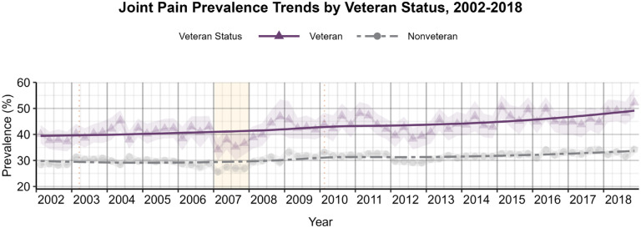
Veteran pain prevalence vs general population
Taylor KA, Kapos FP, Sharpe JA, Kosinski AS, Rhon DI, Goode AP. Seventeen-Year National Pain Prevalence Trends Among U.S. Military Veterans. medRxiv [Preprint]. 2023 Apr 10:2023.03.27.23287408. doi: 10.1101/2023.03.27.23287408. Update in: J Pain. 2024 May;25(5):104420. doi: 10.1016/j.jpain.2023.11.003. PMID: 37034604; PMCID: PMC10081421.

Slide 18
Stepped Care Model for Pain Management (SCM-PM) VHA is improving pain care through implementation of the Stepped Care Model for Pain Management (SCM-PM)
https://www.va.gov/PAINMANAGEMENT/Providers/index.asp

Slide 19
Sequential and Comparative Evaluation of Pain Treatment Effectiveness Response (SCEPTER)
Richard L. Roudebush VA Medical Center and Stanford University
best approach to manage low back pain
2,500 participants at 20 VA medical centers
one of three treatments:
a web-based pain self-management program,
a web-based intervention combined with a physical therapist-directed exercise program that includes face-to-face appointments
usual care.
second phase:
compare cognitive behavioral therapy, chiropractic care, and a yoga-based intervention.
https://www.research.va.gov/topics/pain.cfm

Slide 20
Spinal Cord Stimulation (SCS)

Slide 21
Dorsal Root Ganglion Stimulation (DRG)

Slide 22
Peripheral Nerve Stimulation

Slide 23
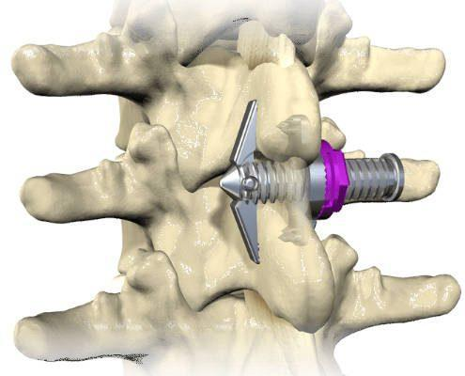
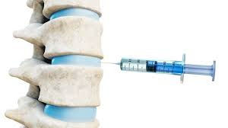
Minimally invasive procedures for spinal stenosis

