Slide 2
Telehealth from the Provider and Patient Landscape: Alexa DeVantier

Slide 3
Patient & Provider Voices

Slide 4
Mission
Patient & Provider Advocates for Telehealth advances policies that ensure robust coverage and minimal access obstacles for those rely upon telehealth.

Slide 5
PPATH Members

Slide 7
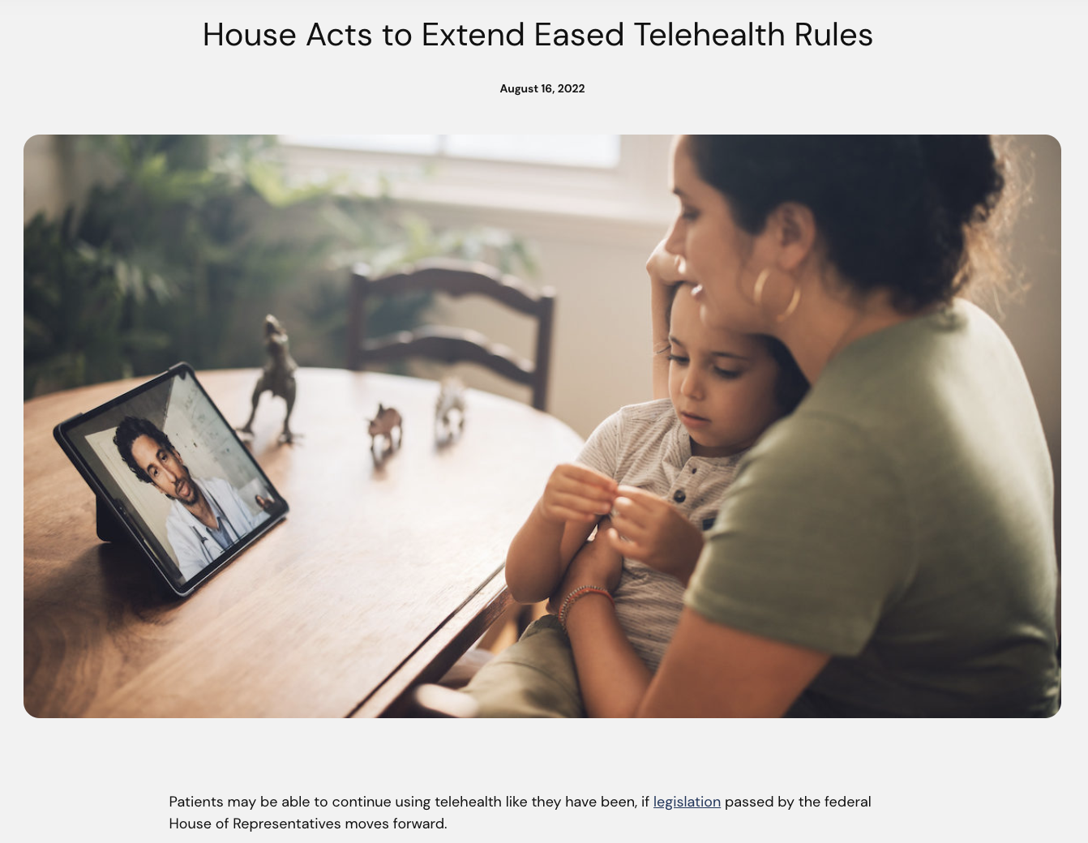
Advocacy & Educational Materials

Slide 8
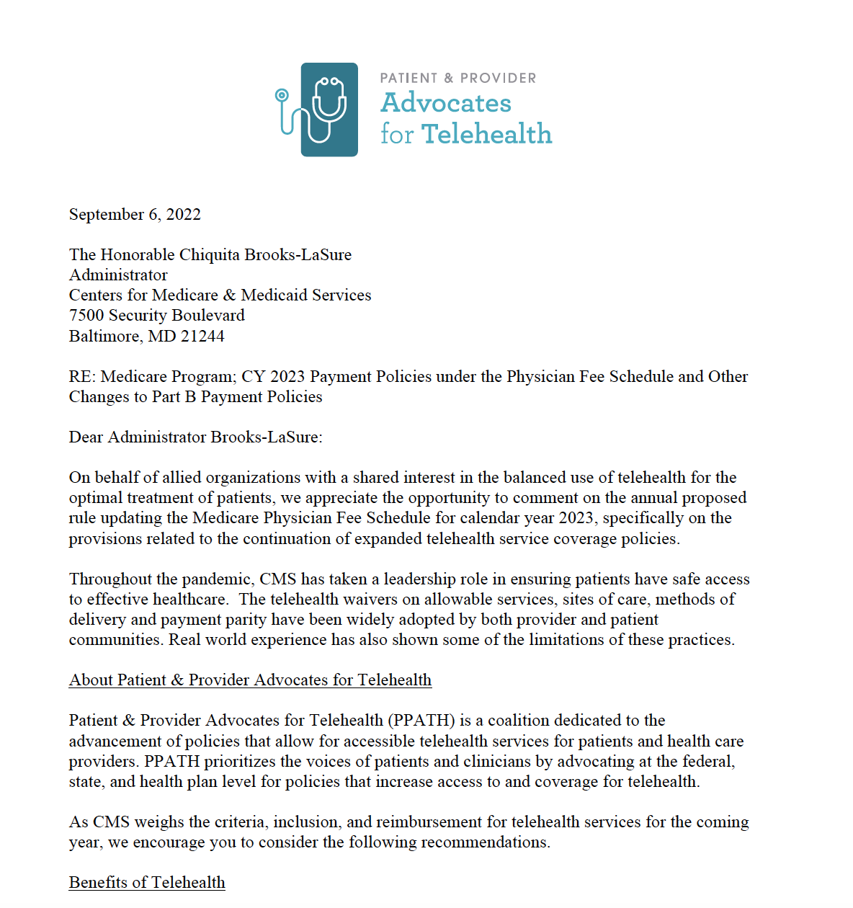
Policies and Regulatory Issues on the Horizon
Regulatory: Physician Fee Schedule Congressional: Advancing Telehealth Beyond COVID-19 Act Inflation Reduction Act

Slide 9
Policies and Regulatory Issues in the States
1. Coverage and Payment Parity 2. Coverage Parity 3. Private Insurance Law does not require payment parity

Slide 10
Your Voice is Critical

Slide 11
QUESTIONS?
Alexa DeVantier
adevantier@allianceforpatientaccess.org

